Slide 1


The Way: Episode 1
C
B
I
S
u
D
A sanity preserving workflow + software package for curating and processing large, heterogeneous BIDS datasets

Slide 2

Defining “The Way”
The PennLINC Way documents standard practices we’ve developed while working with lots of diverse data. The goal is to have a accurately-curated, provenance-tracked, usable data set as a basis for studies.
This presentation will focus specifically on The Way’s recommended practices for curating BIDS datasets. Next week, you will hear from Matt about bootstrapping, datalad, and running containerized pipelines on curated BIDS datasets!

Slide 3
Brief Introduction to Curation of BIDS (CuBIDS)
What is CuBIDS?
A sanity preserving workflow (+ Python package)
aids users in curating (checking and fixing) large, heterogeneous BIDS datasets
A BIDS dataset heterogeneity parser
allows users to easily visualize the heterogeneity present in their dataset.
A tool that prepares BIDS datasets for contaizerized preprocessing pipeline runs
Why CuBIDS?
The BIDS software ecosystem is optimized for fMRI studies with <100 subjects
The validator will fail to run or will produce unusable warnings
PyBIDS can take hours to index n>1000 files
BIDS Apps automatically build workflows based on data
subtle errors or variations in acquisition parameters can result in “successful” runs that implement different preprocessing steps for different subjects.

Slide 4
CuBIDS Definitions
Filename Group (formerly known as “key group”)
A unique set of BIDS key-value pairs excluding identifiers such as subject and session.
Derived from the filename
Example structure: acquisition-*_datatype-*_run-*_task-*_suffix
Within a filename group, all scanning parameters are expected to be identical
Parameter (Param) Group
The set of scans with identical critical imaging parameters.
Numerically identified (e.g. 1, 2, etc.)
These parameters affect how BIDS Apps will configure their pipelines (e.g. fieldmap availability, multiband factor, etc).
Filename: sub-2675724304_ses-PNC1_task-rest_acq-singleband_bold.nii.gz
Filename Group: acquisition-singleband_datatype-func_suffix-bold_task-rest
Param Group: 1

Slide 5
CuBIDS Definitions
Dominant Group
The Param Group that contains the highest number of scans in its Filename Group
Variant (or non-dominat) Group
Any Param Group that is non-dominant (>1)
Rename Group
New Key Group name CuBIDS will assign to a non-dominant Param Group
CuBIDS will suggest renaming any non-dominant Param Group to include VARIANT* in their acquisition field where * is reason the Param Group varies from the dominant
e.g. acquisition-VARIANTRepetitionTime
When cubids-apply is run, filenames will get renamed according to the auto-generated rename group.

Slide 6
CuBIDS Definitions
Dominant Group
Filename: sub-2675724304_ses-PNC1_task-rest_acq-singleband_bold.nii.gz
Filename Group: acquisition-singleband_datatype-func_suffix-bold_task-rest
Param Group: 1
Variant Group
Filename: sub-1682850665_ses-PNC1_task-rest_acq-singleband_bold.nii.gz
Filename Group: acquisition-singleband_datatype-func_suffix-bold_task-rest
Param Group: 2
Rename Group: acquisition-singlebandVARIANTNoFmap_datatype-func_suffix-bold_task-rest

Slide 7
CuBIDS Definitions
Summary CSV
cubids-group output that breaks the dataset down by Param Group
One row for each Param Group
Allows the user to manipulate the BIDS dataset through a csv
Files CSV
cubids-group output that breaks the dataset down by file
Lists all scanning parameters for each file
Acquisition Group
A collection of subjects or sessions that contain the same set of Param Groups.
Ideally, a BIDS App should handle all scans in a given Acquisition Group in the same way.
Acquisition Grouping CSV
bond-group output that breaks down the dataset by subject or session
One row for each subject or subject/session pair
Tags each subject or subject/session pair with it’s acquisition group number

Slide 8
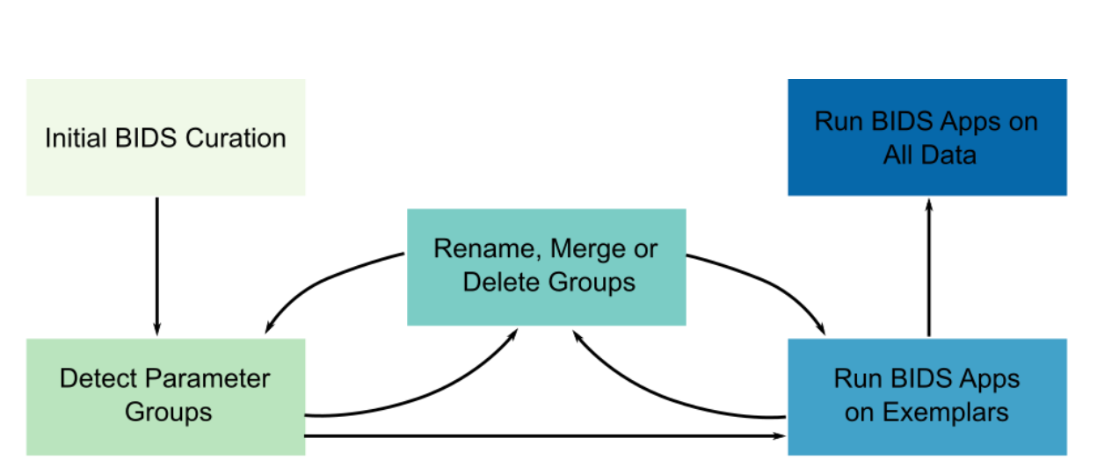
CuBIDS Workflow

Slide 9
CuBIDS CLI Programs
cubids-print-metadata-fields
Prints out all sidecar field names present in the dataset
cubids-remove-metadata-fields
Removes a desired list of metadata fields
Can be used to remove PHI from datasets
cubids-add-nifti-info
Adds a nifti’s Obliquity, NumVolumes, Dim*Size, and VoxelSizeDim* to its corresponding sidecar
cubids-validate
Robust, scalable, easy-to-use version of the BIDS-validator

Slide 10
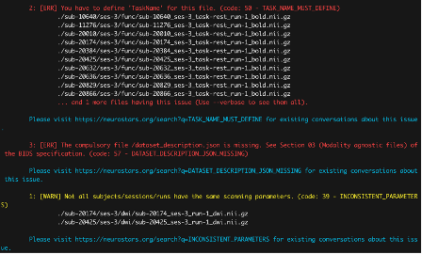
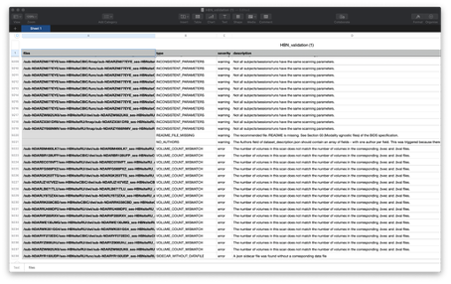

Slide 11
CuBIDS CLI Programs
cubids-group
Outputs csvs parsing dataset heterogeneity based on filename, parameter, and acquisition groups
cubids-purge
Takes in a list of niftis and removes them + all their association files and IntendedFor references from the dataset
cubids-apply
Applies the user’s edits to the *_summary.csv file to the BIDS dataset
cubids-undo
Reverts dataset to it’s state prior to the most recent modifications
cubids-copy-exemplars
Copies one subject from each exemplar group into a separate directory

Slide 12
Customizability
CuBIDS’ latest feature is a customizable, modality-specific configuration file
Passed as an argument to cubids-group and cubids-apply
Allows users to:
Customize grouping settings based on modality
Each key group is associated with one and only one modality
Add/remove scanning params from the set that determines groupings
Set tolerances for determining groups for scanning parameters with numerical values
Determine which scanning parameters end up in the acq string for the auto renaming
Example Config

Slide 13
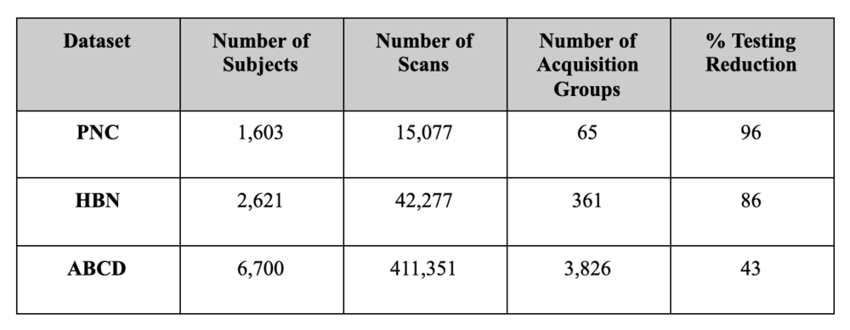
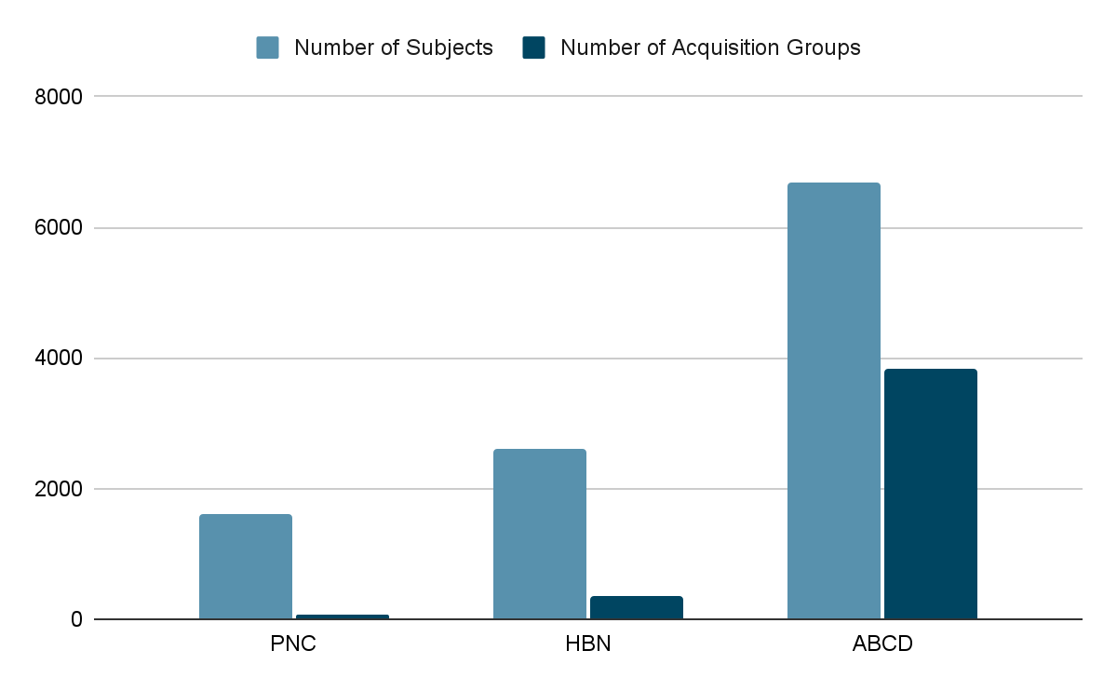

Slide 14
Conclusions
Implementing the CuBIDS workflow facilitates efficient identification and correction of issues present in the metadata of large, heterogeneous BIDS datasets.
By first verifying that BIDS Apps perform as intended on this small sub-sample of participants that spans the entire parameter space of the dataset, users can confidently move forward processing the data of the complete cohort.

Slide 15
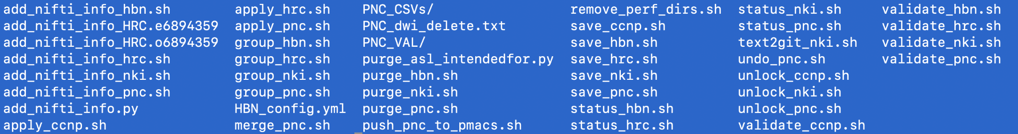
CuBIDS + RBC Curation
RBC is the perfect test case for CuBIDS––large, heterogeneous, multimodal
PNC summary csv pre and post cubids-apply
The validation and summary csv outputs catch different issues
With RBC, we have been purging scans with too low number of volumes or dimension sizes, which can clearly be discerned from the summary csv
Always run group and validate simultaneously on the same dataset post making changes

Slide 16








CCNP
PNC
HBN
NKI
HRC
ABCD
HCP-D
HBCD
Rosmap
Reward
ms-depression
Others from logos listed below

Slide 17
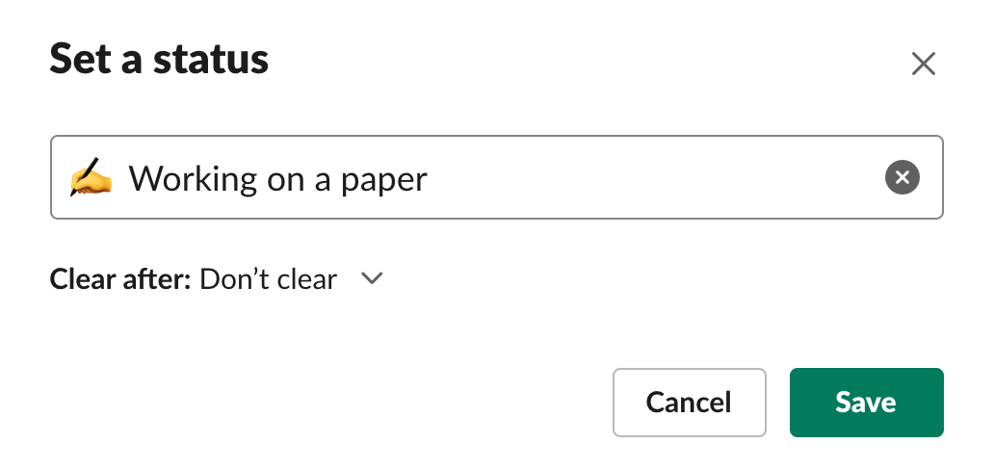
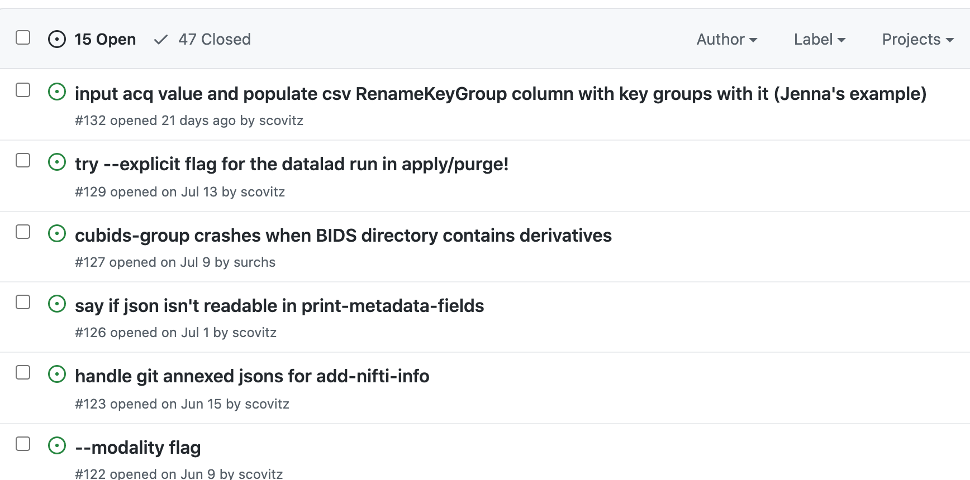
Up Next

Slide 18
Lessons from this Process
WRITE TESTS FOR YOUR CODE EARLY AND OFTEN!
CircleCI is your friend!
PyBIDS might let you down, but your team members won’t!
Descriptive variable names are essential
Building something other people actually use is exciting, rewarding, and REALLY FUN!
If you are passionate about a project, go after it, even if you’re new to the team/young/know very little.

Slide 19
A Few People Who Are AWESOME
Matt Cieslak!!!!!!
Tinashe Tapera
Theodore Satterthwaite
Jake Vogel & Jenna Young + anyone else who was BRAVE enough to use CuBIDS before we finished building it :)

Slide 20

DAD BOD → BoND → CBD → CuBIDS
CoBID-19
Notes:
CoBID-19

